Slide 1
Soft Robots
The Soft Robot Walker – An Application Example

Slide 2
Agenda What we have in Store
1. Central Differences: Of Soft and Conventional Robots
2. Soft Robot Walker: Basic Information
3. Soft Robot Walker: Capabilities
4. Soft Robot Walker: Overview

Slide 3
Central Differences Of Soft and Conventional Robots
Property | Soft Robots | Conventional Robots
Material | adaptable (e.g., polymers) | rigid (e.g., metals)
Adaptability | highly flexible, therefore suitable for hazardous and changing environments | lower flexibility, more suitable for predictable environments
Contact with people | safe to use around people thanks to flexible components | may require additional safety measures
Milana, E. (2022)
Yasa, O., Toshimitsu, Y., Michelis, M. Y., Jones, L. S., Filippi, M., Buchner, T., & Katzschmann, R. K. (2023)

Slide 4
Central Differences Of Soft and Conventional Robots
Property | Soft Robots | Conventional Robots
Economy | provides opportunities for reducing energy consumption | higher energy consumption for adaptation to their environment
Wear | less mechanical wear | more susceptible to wear and tear over time
Production Costs | cost-effective, 3D-printable at home in many different versions | often requires expensive and specialized machinery
Milana, E. (2022)
Yasa, O., Toshimitsu, Y., Michelis, M. Y., Jones, L. S., Filippi, M., Buchner, T., & Katzschmann, R. K. (2023)

Slide 5
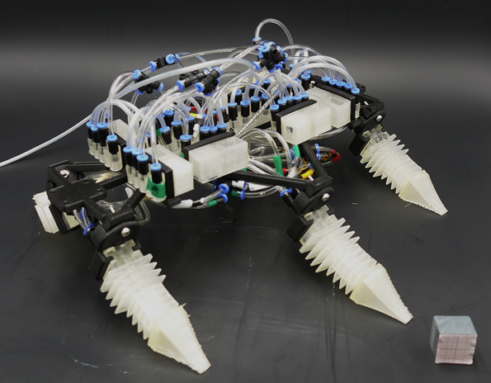
Soft Robot Walker Basic Information
New type of soft robot
Movement via inexpensive 3D-printable circuits
These can be switched on and off using a modular design principle
The robot can be expanded as desired (modular)
Compressed air as the solely needed energy source (hose or cartridge)
Teichmann, J., Auth, P., Conrad, S., Speck, T., & Tauber, F. J. (2023)

Slide 6
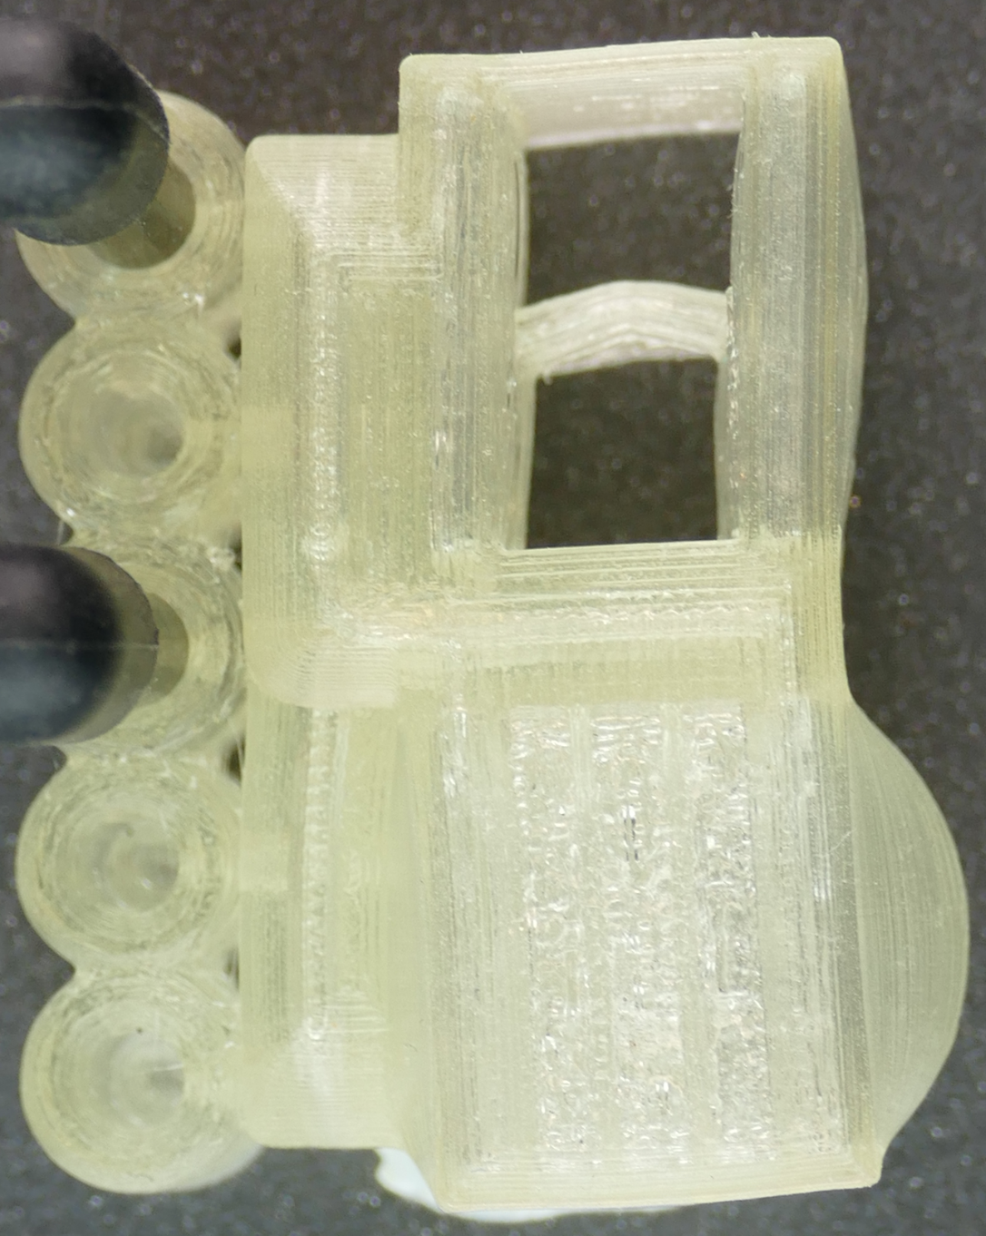
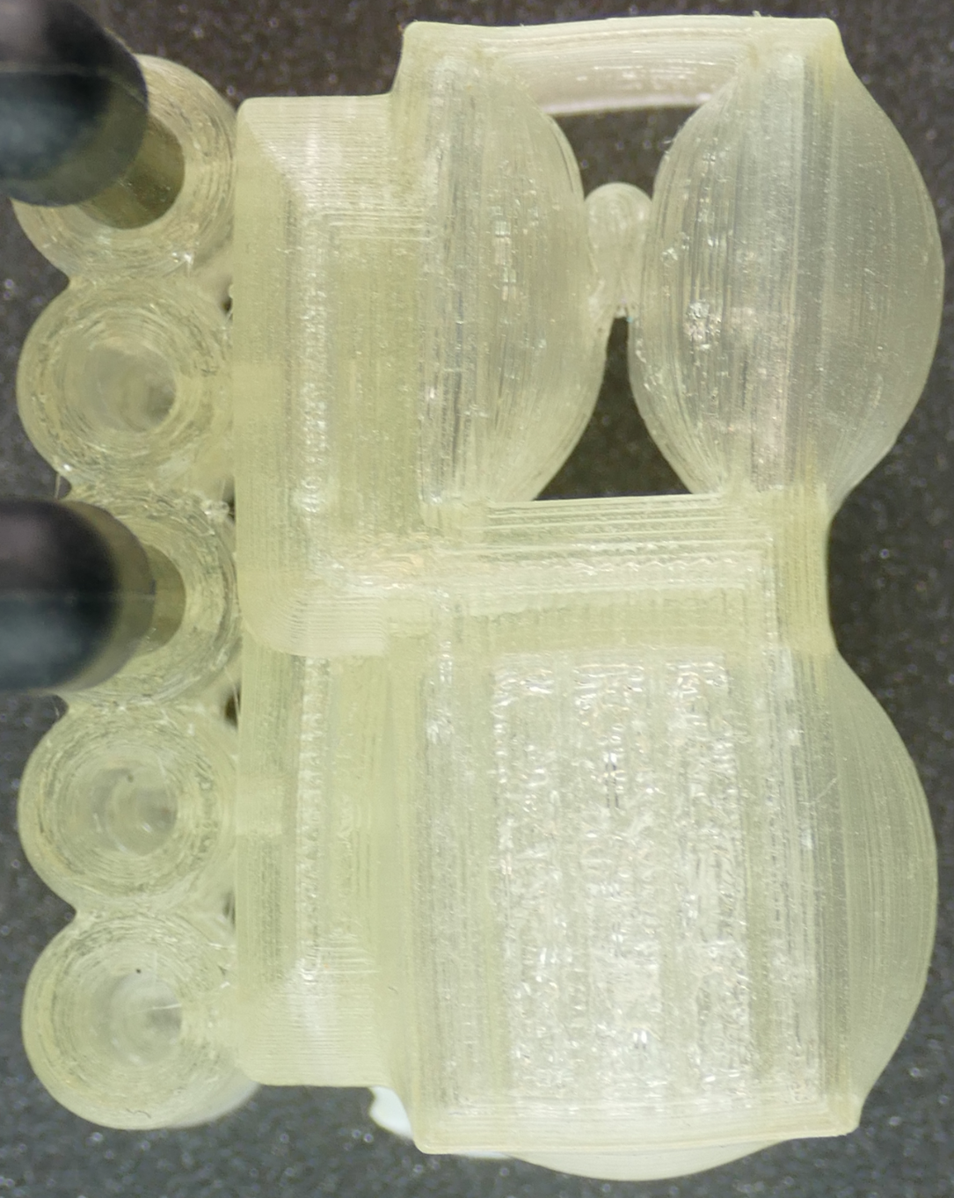
Soft Robot Walker Basic Information
This robot consists of
modular circuits
On and off by bending
a hose between two membranes → program sequence controlled by air pressure
Binary logic (air yes, air no / on, off / 0, 1) → comparable possibilities to those of a PC
The more circuits are connected, the more complex the movement sequences become
Hose Unbent
Hose Kinked
Conrad, S., Teichmann, J., Auth, P., Knorr, N., Ulrich, K., Bellin, D., Speck, T., & Tauber, F. J. (2024)

Slide 7
Soft Robot Walker Video: Walking
livMatS
Teichmann, J., Auth, P., Conrad, S., Speck, T., & Tauber, F. J. (2023)
© EXC livMatS & PBG Freiburg
Notes:
Hexapod Locomotion (100 fps)
alle mit 45° livmats Schriftzug

Slide 8
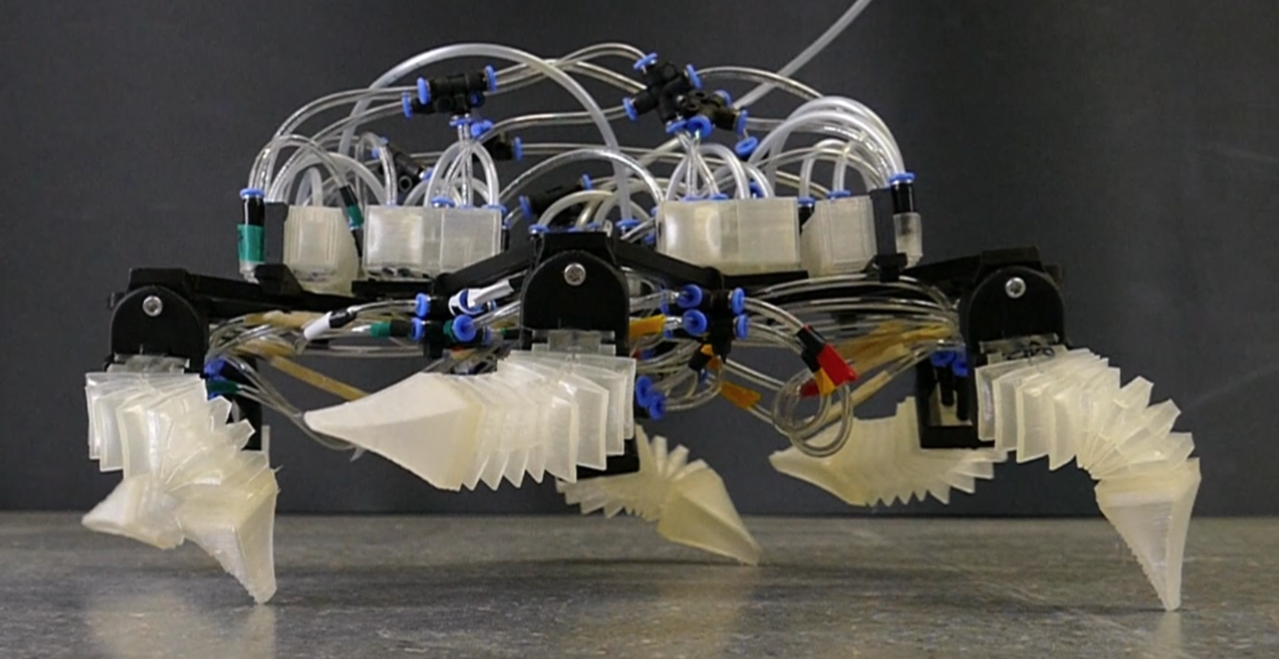
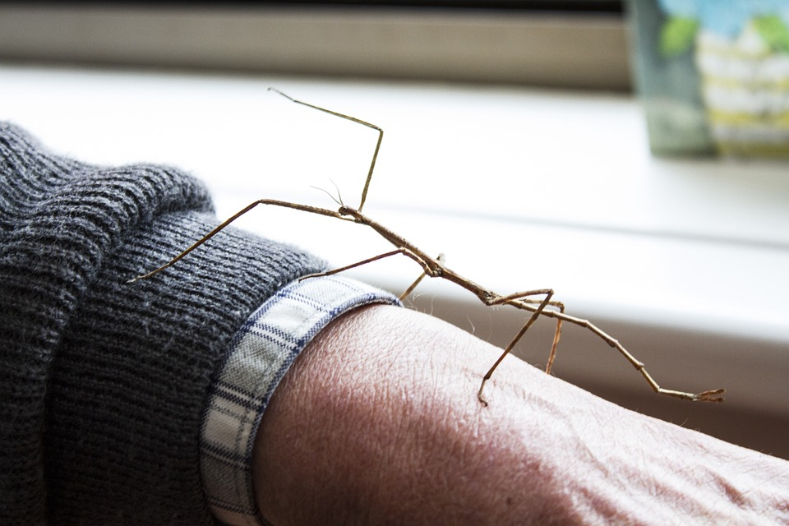
Soft Robot Walker Explanation: Walking
The robot remains stable at all times while walking
Teichmann, J., Auth, P., Conrad, S., Speck, T., & Tauber, F. J. (2023) https://pixabay.com/de/photos/insekt-stabheuschrecke-k%C3%A4fer-insekt-3199770/
Imitation of the walking style
of a stick insect
Notes:
https://pixabay.com/de/photos/insekt-stabheuschrecke-k%C3%A4fer-insekt-3199770/

Slide 9
Soft Robot Walker Video: Obstacle Course
livMatS
Teichmann, J., Auth, P., Conrad, S., Speck, T., & Tauber, F. J. (2023)
© EXC livMatS & PBG Freiburg
Notes:
20240212_141935.mp41709110024925

Slide 10
Soft Robot Walker Video: Gripping
livMatS
Auth, P., Conrad, S., Knorr, N., Teichmann, J., Ruppert, S., Speck, T., & Tauber, F. (2025)
© EXC livMatS & PBG Freiburg
Notes:
Movie S4

Slide 11
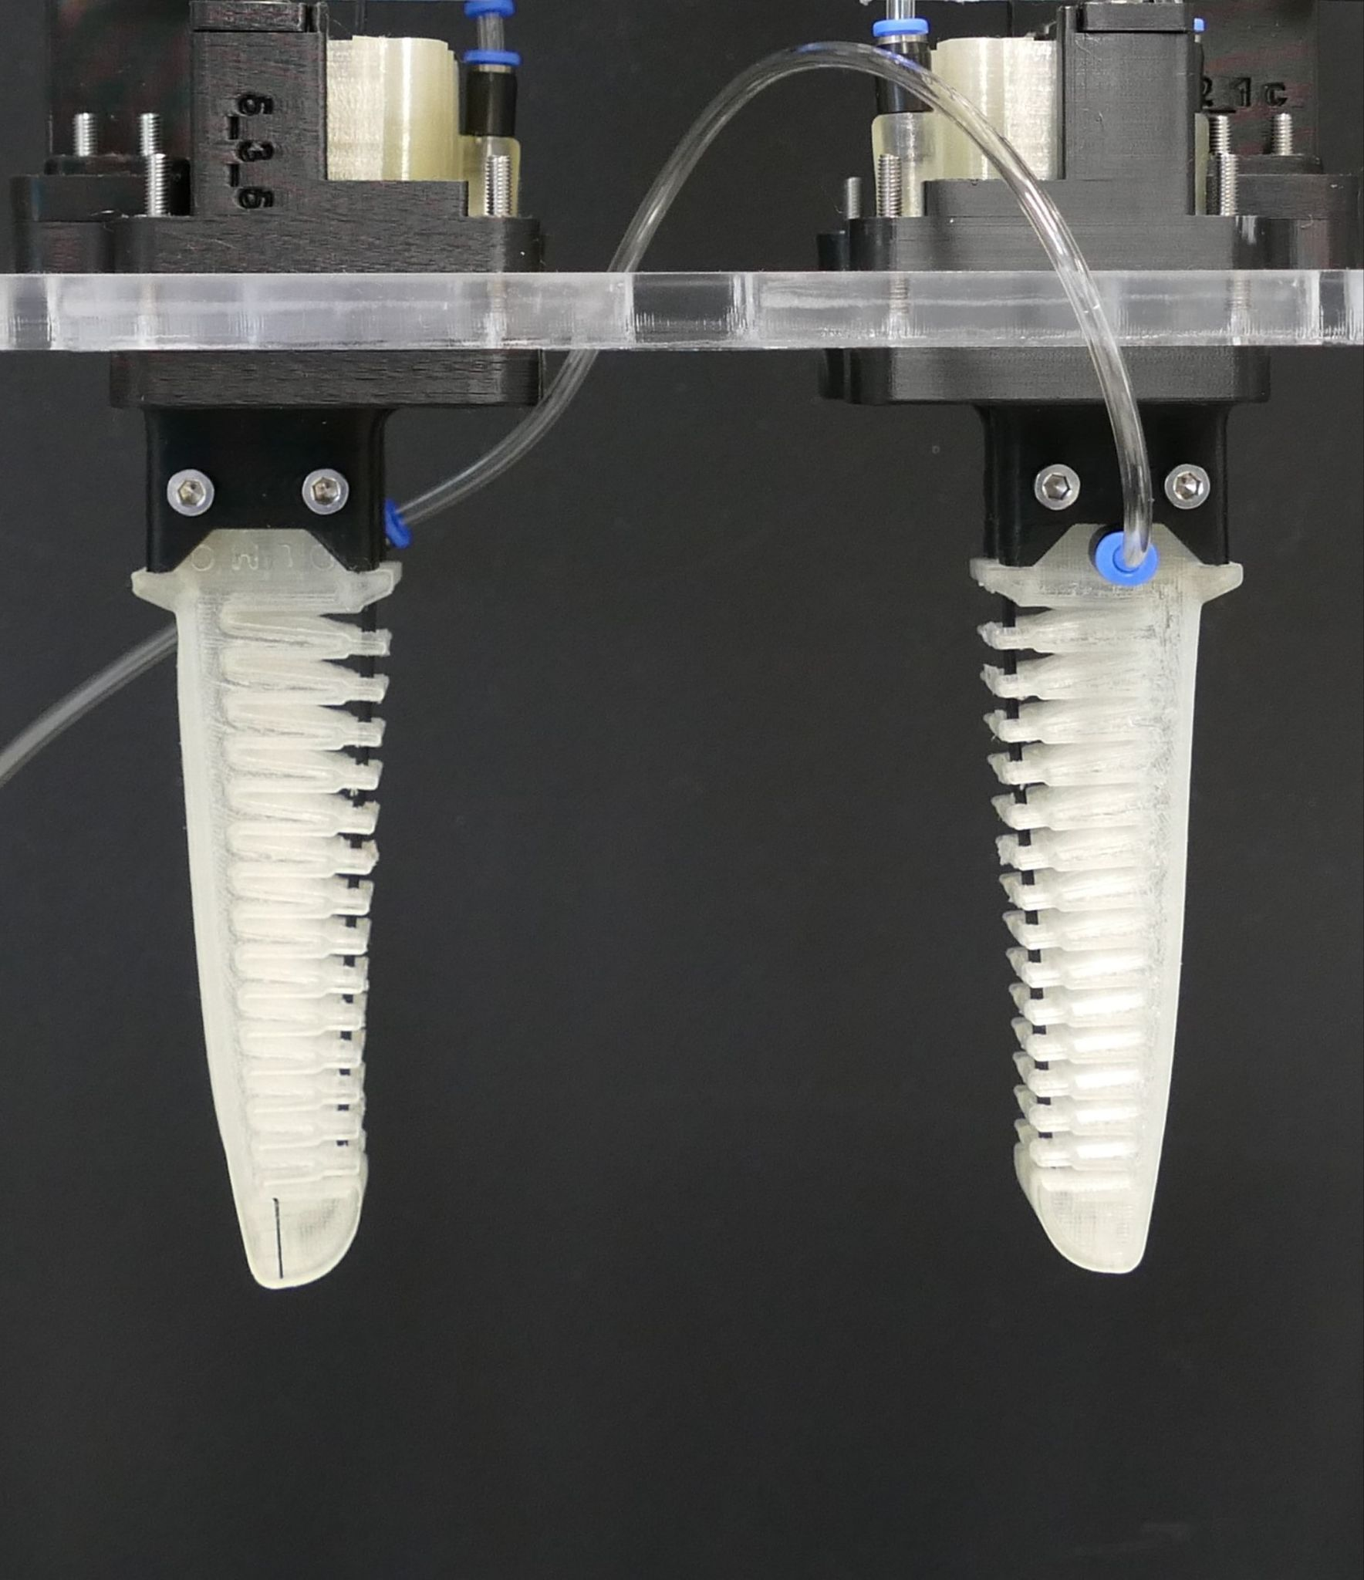
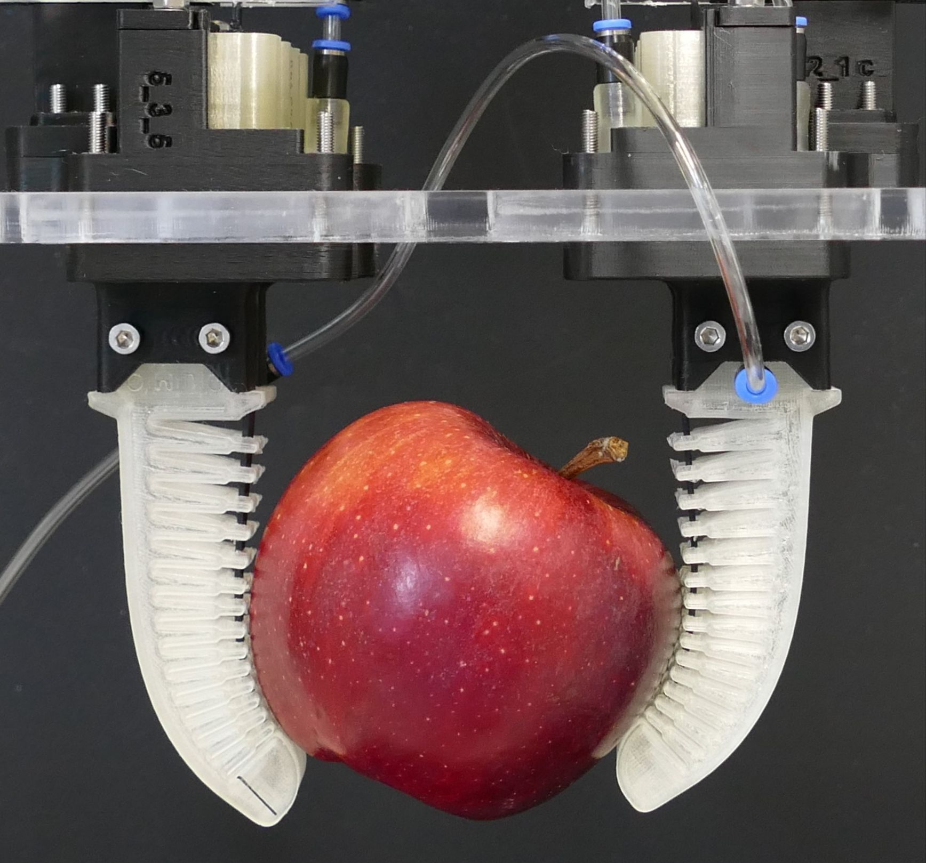
Soft Robot Walker Explanation: Gripping
Arm stiffness can be adjusted using bio-inspired tendons
Tendon free: low stiffness, stretching with lower air pressure
Tendon locked: stiffness and holding force of the gripper arms increased
Advantage
Enables more energy-efficient operation (compared to conventional soft robotic grippers)
© EXC livMatS & PBG Freiburg
Kappel, P., Kürner, L., Speck, T., & Tauber, F. (2023)
© EXC livMatS & PBG Freiburg

Slide 12
Soft Robot Walker Overview
The Soft Robot Walker belongs to a new type of soft robot.
Walking and gripping were demonstrated.
The robot remains stable.
A modular design allows for unlimited expansion and modification.
3D-printed circuits
Completely free of any electronics
Interesting for potentially explosive environments, for example

Slide 13
Literature
Auth, P., Conrad, S., Knorr, N., Teichmann, J., Ruppert, S., Speck, T., & Tauber, F. (2025). Toward More Autonomous Soft Robots: Development and Characterization of a 3D‐Printed Pneumatic Contact Sensor for a Six‐Legged Soft Robotic Walker. Advanced Intelligent Systems. doi:10.1002/aisy.202500430.
Conrad, S., Teichmann, J., Auth, P., Knorr, N., Ulrich, K., Bellin, D., Speck, T., & Tauber, F. J. (2024). 3D-printed digital pneumatic logic for the control of soft robotic actuators. Science Robotics, 9(86), 1–10. https://doi.org/10.1126/scirobotics.adh4060
Kappel, P., Kürner, L., Speck, T., & Tauber, F. (2023). A Pneumatic Bending Actuator System Inspired by the Avian Tendon Locking Mechanism. In F. Meder, A. Hunt, L. Margheri, A. Mura, & B. Mazzolai (Eds.), Biomimetic and Biohybrid Systems (pp. 84–100). Springer Nature Switzerland. https://doi.org/10.1007/978-3-031-39504-8_6
Milana, E. (2022). Soft robotics for infrastructure protection. Frontiers in Robotics and AI, 9, 1–7. https://www.frontiersin.org/articles/10.3389/frobt.2022.1026891
Teichmann, J., Auth, P., Conrad, S., Speck, T., & Tauber, F. J. (2023). An Insect-Inspired Soft Robot Controlled by Soft Valves. In F. Meder, A. Hunt, L. Margheri, A. Mura, & B. Mazzolai (Eds.), Biomimetic and Biohybrid Systems (pp. 428–441). Springer Nature Switzerland. https://doi.org/10.1007/978-3-031-38857-6_31
Yasa, O., Toshimitsu, Y., Michelis, M. Y., Jones, L. S., Filippi, M., Buchner, T., & Katzschmann, R. K. (2023). An Overview of Soft Robotics. Annual Review of Control, Robotics, and Autonomous Systems, 6(1), 1–29. https://doi.org/10.1146/annurev-control-062322-100607

